Slide 1
Lecture No. 7 Storage Devices - Batteries
At the end of this lecture, students will be able to:
Explain the working principle of Ni-Cd, Ni-MH and lithium ion batteries
Describe the construction of Ni-Cd, Ni-MH and lithium ion batteries
Discuss the applications and environmental impact of batteries

Slide 2
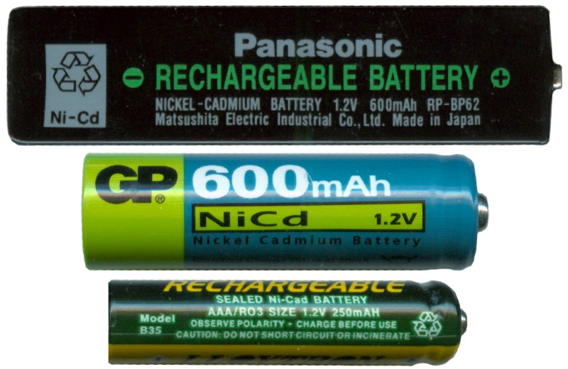
Nickel-Cadmium Battery
Nickel-Cadmium battery (commonly abbreviated NiCd or NiCad) is a type of rechargeable battery
Nickel Cadmium consists of nickel wire gauze electrode grids
Anode grid consists of a mixtures of spongy cadmium with 78% cadmium hydroxide, 18% iron, 1% Nickel, and 1% graphite
Cathode grid contains 80% nickel hydroxides, 2% Cobalt hydroxide, 18% graphite and traces of barium compound
Graphite increases the conductivity, Barium and cobalt compounds increases the efficiency of active material and cycle life. 6 M KOH is the electrolyte

Slide 3
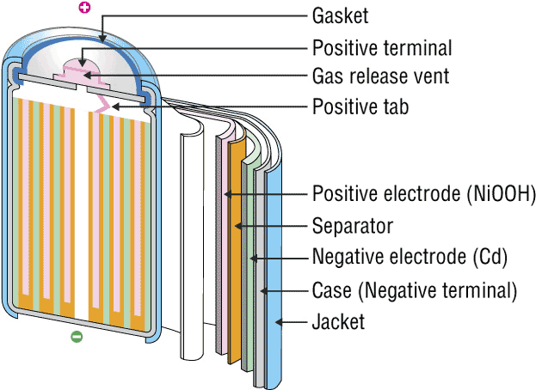
Nickel-Cadmium Battery
Ni-Cd Battery
Button type cell
Anode
Contact Spring
Sealing Washer Separator
cathode
Specific energy | 40–60 W·h/kg
Energy density | 50–150 W·h/L
Specific power | 150 W/kg
Charge/discharge efficiency | 70–90%
Self-discharge rate | 10%/month
Cycle durability | 2,000 cycles
Nominal cell voltage | 1.2 V
Cylindrical cell

Slide 4
Nickel-Cadmium Battery
Applications: It is used in Pocket calculators, Photo flash units, cordless garden tools, electric shavers, instruments, alarms system, transmitters, energy light, hearing aids, telemeters and Receivers

Slide 5
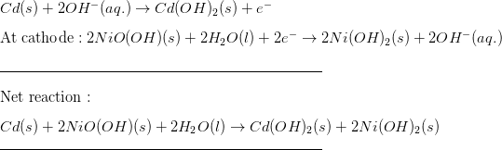
Nickel-Cadmium Battery
Limitations: The primary trade-off with Ni–Cd batteries is their higher cost and the use of cadmium
Ni-Cd Battery exhibits a very marked negative temperature coefficient
As the cell temperature rises, the internal resistance falls
Poses considerable charging problems

Slide 6
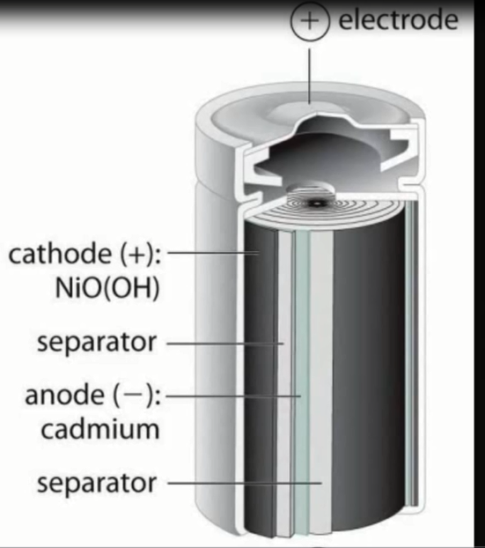
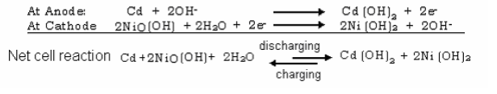
Nickel-Cadmium Battery

Slide 7
Environmental Impact
Ni–Cd batteries contain between 6% and 18% cadmium, which is a toxic heavy metal harmful to all higher forms of life
Cd is primarily toxic to the kidney, can cause bone demineralization, excessive exposures to airborne Cd may impair lung function and increase the risk of lung cancer
Industrial Ni–Cd batteries must be collected by their producers after use in order to be recycled in dedicated facilities
Cadmium, being a heavy metal, can cause substantial pollution when discarded in a landfill or incinerated
Many countries now operate recycling programs to capture and reprocess old batteries

Slide 8
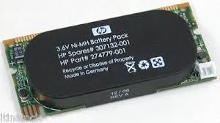
Nickel-Metal hydride battery
Nickel-Metal hydride battery is similar in its characteristics to Ni-Cd battery
This alloy is capable of undergoing a reversible reaction as the battery is being charged and discharged
Nickel Metal hydride battery is made up of anode containing metal hydride such as ZrH₂, VH₂ and TiH₂ with hydrogen storage metal alloy such as LaNi₅ or TiNi.
Cathode consisting of nickel oxy hydroxide both the compartments are separated by polypropylene
KOH used as electrolyte. Cell reactions are as follows.

Slide 9

Nickel-Metal hydride battery
Cathode is a highly porous Nickel into which the Nickel-oxy-hydroxide is pasted
Anode is a highly porous structure with a nickel wire gauge coated with active hydrogen
5.35 M KOH acts as electrolyte
Anode and cathode are stacked alternatively in a stainless container and connected in series to get desired voltage

Slide 10
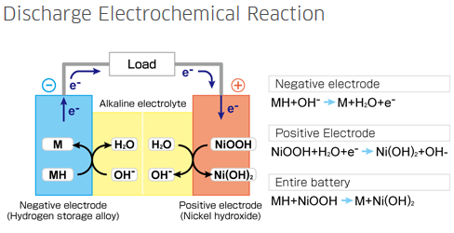
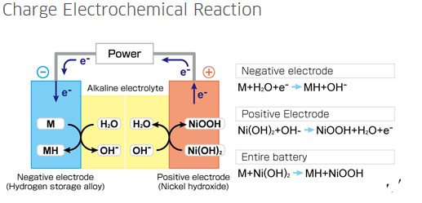
Nickel-Metal hydride battery

Slide 11
Nickel-Metal hydride battery
Specific energy 60–120 Wh/kg
Energy density 140–300 W·h/L
Specific power 250–1,000 W/kg
Charge/discharge efficiency 66%
Cycle durability 500–2000 cycles
Nominal cell voltage 1.2 V

Slide 12
Nickel-Metal hydride battery
Advantages:
Ni-MH batteries have a higher capacity and are now more cost effective
Long shelf life and long cycle life
Minimum environmental problem
Rapid recharging capability

Slide 13
Nickel-Metal hydride battery
Limitations:
Traditional Ni-MH batteries have higher self discharge than Ni-Cd batteries (For example: 30% per month for a traditional Ni-MH under identical conditions, versus 20% per month for Ni-Cd batteries)
Now new low self-discharge ("LSD") NiMH batteries are available, which have substantially lower self-discharge than either Ni–Cd or traditional NiMH batteries

Slide 14

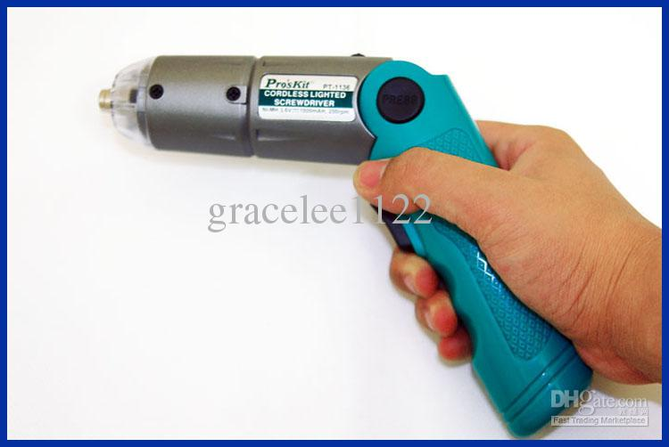
Applications
Applications:
Used in electric vehicles, laptops, cellular phones etc.
Advantages:
Resistance to chemical oxidation
High energy storage capacity
Ni-MH battery operated Cordless foldable screwdriver with light

Slide 15
Lithium Batteries
Lithium metal is used as anode material in the battery because of its light weight, good conductivity and low specific gravity
Lithium cells are most popularly used cells, which are available in various configurations such as button type, bobbin type, spiral wound prescematic, rectangle etc configuration
Advantages Lithium cells.
These are light in weight.
High energy density
More cycle life.
Ex: Li – MnO₂ cell

Slide 16
Lithium Batteries
Lithium manganese dioxide cell consisting of anode can containing lithium
Cathode can consisting of specially heat-treated manganese dioxide (MnO₂)
Both anode and cathode are seperated by a separator made up of polypropylene impregnated with the electrolyte. (metal salt such as LiCl, LiBr, LiAlCl4 which are mixed in a organic solvent such as 1,2 dimethoxy ethane, and propylene carbonate.)
Cell delivers an emf of 3V

Slide 17

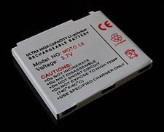
Lithium Batteries
Cell reactions
During the all reactions Mn(IV) stage reduced to Mn(III) state
Uses: Li – MnO₂ cells are used in Safety and Security Devices, Calculator, watches, automatic camera, memory batteries, cellular phones etc.,

Slide 18
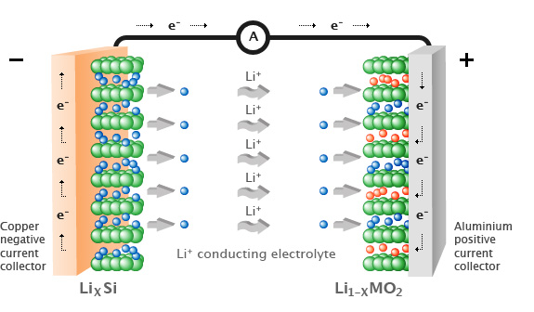
Lithium-ion polymer battery
During the charge and discharge processes, lithium ions are inserted or extracted from interstitial space between atomic layers within the active material of the battery
Li-ion transferred between anode and cathode through lithium Electrolyte
Anode cap
Anode (Li)
Insulating packing
Separator containing electrolyte
Cathode (MnO₂)
Cathode can
Button type cell
LiClO₄
Li
LiMn₂O₄

Slide 19
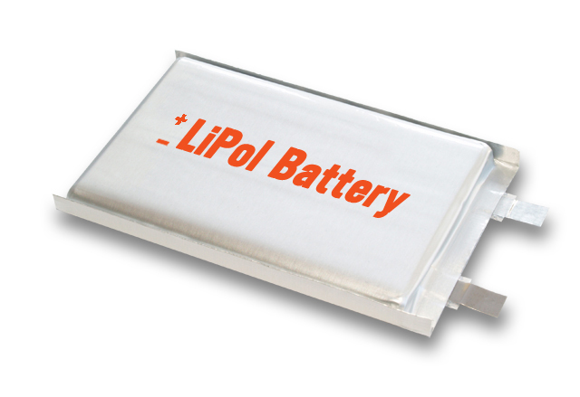
Lithium-ion polymer battery
Characteristics:
Specific energy 100–265 Wh/kg (0.36–0.95 MJ/kg)
Energy density 250–730 Wh/L (0.90–2.23 MJ/L)
Specific power ~250-~340 W/kg
Charge/discharge efficiency 80–90%
Self-discharge rate 8% at 21 °C (per month) 15% at 40 °C (per month) 31% at 60 °C (per month)
Cycle durability 400–1200 cycles
Nominal cell voltage 3.3 - 3.7 V

Slide 20

Lithium-ion polymer battery
Advantages:
High energy density than other rechargeable batteries
160% greater power than NiMH
220% greater power than NiCd
Less weight
Produce high voltage output about 4V as compared with other batteries
Improved safety, i.e. more resistance to overcharge
No liquid electrolyte means they are immune from leaking
Fast charge and discharge rate
It has good shelf life (only 5% discharge loss per month, 10% for Ni-MH, 20% for Ni-Cd)

Slide 21
Lithium-ion polymer battery
Disadvantages:
EXPENSIVE -- 40% more than Ni-Cd
DELICATE -- battery temperature must be monitored from within (which raises the price), and sealed particularly well
Conventional Li-ion chemistry starts to suffer as the temperature drops below 0°C
Currently, the state-of-the-art lithium-ion system has been demonstrated to operate over a wide range of temperatures (–40 to +40°C)

Slide 22
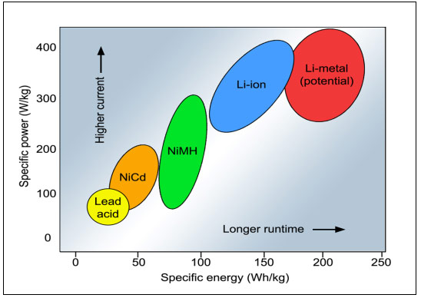
Comparative Performance of Different Batteries

Slide 23

Applications
In watches, Calculators, Cameras, Lighting equipment etc
NASA missions aimed at exploring the Moon, Mars, and the outer planets require rechargeable batteries that can operate over a wide temperature range (–60 to +60°C) to satisfy the requirements of various applications including lande rovers, penetrators, etc.

Slide 24









Applications

Slide 25

Environmental Impact
These batteries are often recyclable
Oxidized Lithium is non-toxic, and can be extracted from the battery, neutralized, and used as feedstock for new Li-Ion batteries

Slide 26
Interesting Idea…..
Background:
Battery research results in annual capacity gains of approximately 6%
Moore’s Law: The number of transistors on a computer microchip will double every two years. (40 years of proof!)
Idea: If battery technology had developed at the same rate, a heavy duty car battery would be the size of a coin

Slide 27
Summary
Construction and working principle of
Ni-Cd: Cd(s) +2NiO(OH) + 2H₂O(l) → Cd(OH)₂ +2Ni(OH)₂ +1.35V
Ni-MH:
Lithium ion polymer batteries:
Charging

Discharging
MH +NiO(OH) M +Ni(OH)₂ + 1.35 V
Charging

Discharging
Mn₂O₄ +LiC₆ LiMn₂O₄ +6C + 3.3V

